Slide 1

AWS Global Infrastructure

Slide 2
Regions
Availability Zones Edge Locations
AWS Global Infrastructure

Slide 3

Reviewing the three elements of the AWS global infrastructure
Overview
Understanding the use of AWS Regions
Understanding Availability Zones within AWS Regions
Reviewing the purpose of Edge Locations
Utilizing the AWS global infrastructure visualization

Slide 4
AWS Regions and Availability Zones

Slide 5
Each region is in a specific geographic location
AWS Regions
Each geographic location has a cluster of data centers
AWS currently has 22 launched regions

Slide 6

























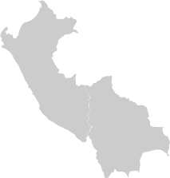


AWS Regions

Slide 7
Consists of one or more data centers
Multiple availability zones are included with each AWS Region
Located within the geographic area of the AWS Region
Redundant power, networking and connectivity
There are currently 69 availability zones globally
Availability
Zones

Slide 8
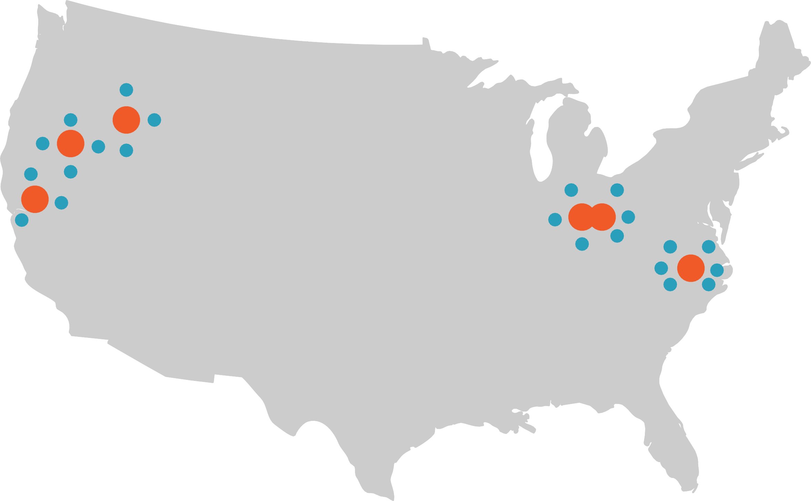

US AWS REGIONS
REGION
AVAILABILITY ZONE

Slide 9
Availability
Extent to which an application is fulfilling its intended business purpose. Applications that are highly-available are built in a manner where a single failure won’t lessen the application’s ability to be fully operational.

Slide 10
Region and Availability Zone Naming
us-east-2a
Area Sub-area Number AZ
Region Name Availability Zone Name

Slide 11
AWS Regions
Region | Region Identifier
US East (Ohio) | us-east-2
US East (N. Virginia) | us-east-1
US West (N. California) | us-west-1
US West (Oregon) | us-west-2
Asia Pacific (Hong Kong) | ap-east-1
Asia Pacific (Mumbai) | ap-south-1
Asia Pacific (Seoul) | ap-northeast-3
Asia Pacific (Singapore) | ap-northeast-2
Asia Pacific (Sydney) | ap-southeast-1
Asia Pacific (Tokyo) | ap-southeast-2
Region | Region Identifier
Canada (Central) | ca-central-1
Europe (Frankfurt) | eu-central-1
Europe (Ireland) | eu-west-1
Europe (London) | eu-west-2
Europe (Paris) | eu-west-3
Europe (Stockholm) | eu-north-1
Middle East (Bahrain) | me-south-1
South America (São Paulo) | sa-east-1

Slide 12
AWS Edge Locations

Slide 13
Used as nodes of a global content delivery network (CDN)
Utilized by Amazon CloudFront and Amazon Route 53
Located globally at over 200 different locations
Allows AWS to serve content from locations closest to users
Edge Locations

Slide 14











AWS Edge Locations

Slide 15
Visualizing AWS Global Infrastructure

Slide 16
Scenarios

Slide 17

Scenario 1
Jane’s company is looking to transition to AWS
They are starting with a few workloads
It is a requirement to store backup data in multiple geographic areas
Which element of AWS global infrastructure will best suit this need?

Slide 18

Scenario 2
Tim’s company serves content through their site to users around the globe
They are looking to optimize performance to users around the world
They want to leverage a Content Delivery Network (CDN)
Which element of the AWS global infrastructure will be used in this case?

Slide 19

Scenario 3
Ellen’s company is transitioning one of their legacy applications to AWS
This application requires uptime of at least 99.5%
They want to be sure any issues at a single data center don’t cause an outage
Which element of the AWS global infrastructure supports this need?

Slide 20
Summary

Slide 21
Reviewed the three elements of the AWS global infrastructure
Summary
Understood the use of AWS Regions
Understood Availability Zones within AWS Regions
Reviewed the purpose of Edge Locations

Slide 22
Scenario 1
Jane’s company is looking to transition to AWS
They are starting with a few workloads
It is a requirement to store backup data in multiple geographic areas
Which element of AWS global infrastructure will best suit this need?
Solution: AWS Region

Slide 23
Scenario 2
Tim’s company serves content through their site to users around the globe
They are looking to optimize performance to users around the world
They want to leverage a Content Delivery Network (CDN)
Which element of the AWS global infrastructure will be used in this case?
Solution: AWS Edge Location

Slide 24
Scenario 3
Ellen’s company is transitioning one of their legacy applications to AWS
This application requires uptime of at least 99.5%
They want to be sure any issues at a single data center don’t cause an outage
Which element of the AWS global infrastructure supports this need?
Solution: AWS Availability Zone (AZ)

